Slide 1
U.S. and the Panama Canal

Slide 2
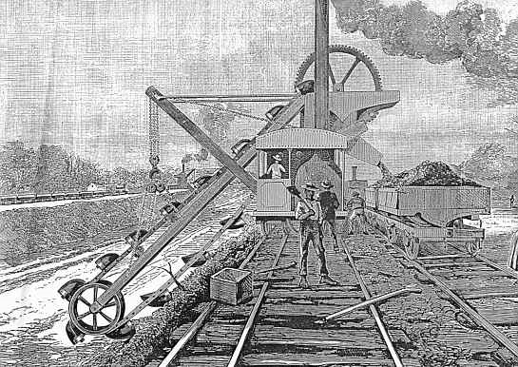
Early French Construction Failure
The French began construction on January 1, 1880 under Ferdinand de Lesseps.
The construction commenced under haste and without full knowledge of the geographic region.
During excavation, the steep angles made rainfall produce landslides which caused ground to be put back which was nearly as equivalent to the amount removed.
High sick and death rate contributed by the diseases malaria and yellow fever cause severe health issues to laborers, construction engineers and French directors.
This condition escalated quickly because the knowledge of mosquitos as vectors for the diseases was unknown, thus health measures were ineffective.
Because of this, many of the French labor force returned to France, thus causes the French to abandon the scheme of construction.

Slide 3
Background
The Panama Canal is one of the greatest works of engineering and achievements. A water way connecting the Atlantic and the Pacific oceans so that one would not have to go around the tip of South America has been proposed since the 16th century. The French were one of the first who actually began to work on the building the canal in 1881, but in the end the French was not able to build it. The United States took on the challenge to finish building the Panama Canal. They finally accomplished this goal in 1914. To achieve this goal they had to overcome many difficulties which the French were not able to face which allowed to U.S. to finish a seemly impossible task.

Slide 4
U.S. Involvement
After the war with Spain, the U.S. needed a speedy way in which her colonies could communicate with her trading interest in the Atlantic and pacific .
The U.S. was very interested at the time, to build a canal across Central America and looked towards Nicaragua (Nicaragua Canal).
Nicaragua was favoured first because it had water ways and roads interest already by the Americans and also because the route could take in Lake Nicaragua. The Panama was then favoured as the rural area provided more protection and camouflage by its jungle and the roads were rugged.
In June 1902, the U.S. senate voted in favor of the Panama Canal. On January 22, 1903, a treaty was signed between the U.S. and Colombia for property rights for the canal.
The U.S. president, Theodore Roosevelt then bought out the equipment and excavations from the French majority shareholder, Philippe Buneau-Varilla for $40 US million.

Slide 5
U.S. Involvement
Shortly after, the U.S. president was informed of a possible revolt for the separation of Panama from Columbia and was asked for support.
U.S. warships were sent to render aid and blocked Colombian troops from suppressing the revolt which lead to Panama’s independence on November 3, 1903.
After Panama gained its independence, the ambassador of Panama to the U.S. signed the Hay-Buneau Varilla Treaty, which gave rights to the U.S. to build and indefinitely manage the Panama Canal.
After Panama gained its independence, the ambassador of Panama to the U.S. signed the Hay-Buneau Varilla Treaty, which gave rights to the U.S. to build and indefinitely manage the Panama Canal.

Slide 6
The treaty stated that Panama was an independent state and said that the U.S. had the right to build the canal the build the canal and own a zone of land on each side.
Inside the zone, the treaty also stated that America could act as the ‘sovereign of the territory’ and Panama had no right there.
They were also to maintain police and shipping officials presence in the port cities of Panama and Colon.
Work commenced on May 4, 1904.
Nine years after the treaty, the U.S. agreed to pay an annual rent of £250,000.
Shortly after in 1914, the first vessels passed through the canal.
The Panama Canal was completed in 1920 and was open freely to all shipping activities.

Slide 7
